Slide 1
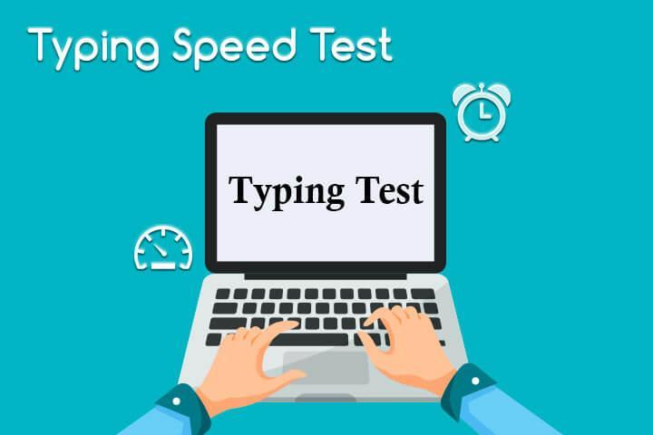
Typing speed test(python) Presented by: k . Sowmya reddy(18r05a0523) p. udaya sree(17r01a05f5) u . vikhitha sindhu(17r01a05h2) a. Shivani(17r01a05j1)

Slide 2
ABSTRACT:
The Typing Speed In Python is a simple project for improving your Typing speed. The project contains only the user side. It is a simple typing challenge game mini-project. This is like a game, one-by-one random word will pop up on your screen and you have to type as many given words as you can. Typing games are a great way to learn the position of all the keys on the keyboard and also help you practice your typing while having fun.

Slide 3
The project file contains python scripts. This app project just contains the user section. The player/user can improve their Typing speed playing this game. You have to type as many words as you can in the given amount of seconds to score. Otherwise, you will lose the game, and to play again, you just have to type the current word. Also, your score will be reset and the high score will be set on the game. The design of this project is pretty simple so that the user won’t find any difficulties while working on it.

Slide 4
EXISTING SYSTEM:
In the market most of the typing speed test tools are build in Java. We know how robust Java code is and also upon research we found out that the speed testing tools built in java are not as accurate.
The disadvantage of having the code is the complexity of java and also the efficiency when compared to the python model.
So, our proposal is to build this project in python which is more accurate and efficient.

Slide 5
PROPOSED SYSTEM:
In this python project, it is user- friendly, efficient and accurate than java code and you will figure out how to make a speed typing test using python. It's an extremely helpful project to keep track of your typing speed and improve it with regular practice. This mini python project is very interesting, simple and best for practice purposes.

Slide 6
Speed Typing Test is a python based project that will check your typing speed in wpm (word per minute), accuracy, correct & wrong words, most missed words, most inaccurate words, etc. This can be useful and helpful for those people who are not good at typing, they can do this test and get to know where they need to improve.

Slide 7
ADVANTAGES
Save Time : Typing is something most of us will have to do a lot of in our jobs. Whether you work in an office or not, you will probably end up having to type on a computer keyboard on a weekly or even daily basis.
Be More Productive : Everyone is looking for ways to be more productive both in the workplace and at home, and typing faster is a simple way to get more done.
Improve Your Posture : Posture may not be the first thing you think about when you decide to increase your typing speed, but it can certainly benefit.
Learn to Type Faster : Learning to type faster will provide you with all of these benefits and more, and it really should be considered an essential skill.

Slide 8
Improve Your Focus : Another advantage of learning to type faster is that you will not have to look at the keyboard and think about where your fingers are going. Once you are typing fast, you will be able to look directly at the screen, and your fingers will type without you even thinking about the movements.
Better Accuracy : Learning to touch type is not just about learning how to type faster. It's also about learning how to type with greater accuracy.
Find More Opportunities : Finally, because touch-typing is such a useful skill that boosts productivity in the workplace, it can help you to find more and better opportunities when it comes to getting a job.

Slide 9
DISADVANTAGES
It can impact ability to take notes, write documents, and keep up with a competitive workplace.
If typing speed is slow, it results in less productivity than other people who can type much faster.

Slide 10
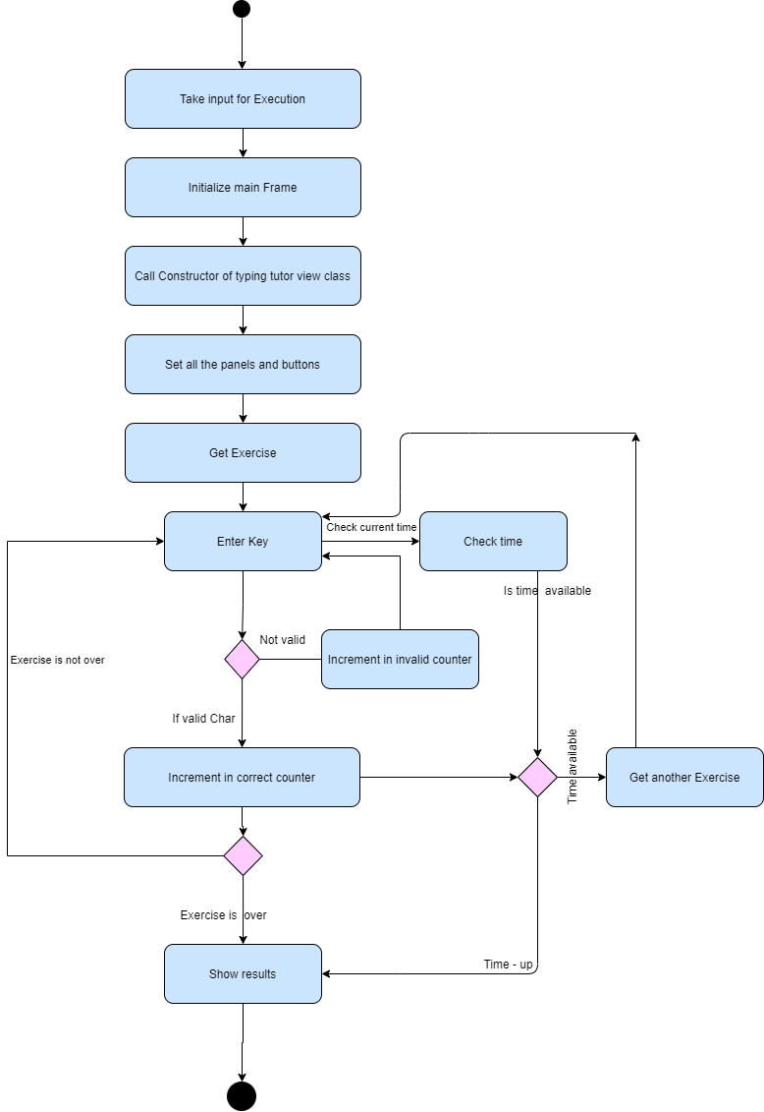
SYSTEM ARCHITECTURE:

Slide 11
HARDWARE REQUIREMENTS:
Modern Operating System:
Windows 7 or 10
Mac OS X 10.11 or higher, 64-bit
Linux: RHEL 6/7, 64-bit (almost all libraries also work in Ubuntu)
x86 64-bit CPU (Intel / AMD architecture)
4 GB RAM
5 GB free disk space
Internet Connection

Slide 12
SOFTWARE REQUIREMENTS:
Programming language – Python
IDLE (Python 3.9 64-bit)
Python 3.9 (64-bit)
Command Prompt

Slide 13
MODULES:
Pygame
pytest-timeit
tkinter

Slide 14
PYGAME:
Pygame library is an open-source module for the Python programming language explicitly proposed to assist you with making games and other mixed media applications. Based on the profoundly versatile SDL (Simple Direct Media Layer) improvement library, pygame can stumble into numerous stages and working frameworks.

Slide 15
PYTEST-TIMEIT:
The pytest framework makes it easy to write small tests, yet scales to support complex functional testing for applications and libraries.
Timeit module that is meant to measure the execution times of small and large code snippets.

Slide 16
TKINTER:
The tkinter package (Tk interface) is the standard Python interface to the Tk GUI toolkit. Both Tk and tkinter are available on most Unix platforms, as well as on Windows systems.

Slide 17
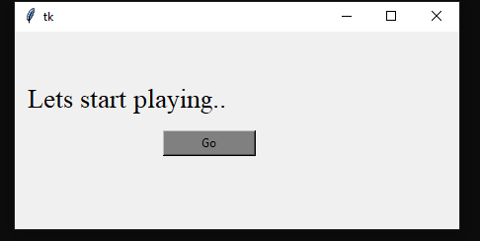
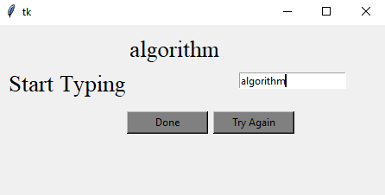
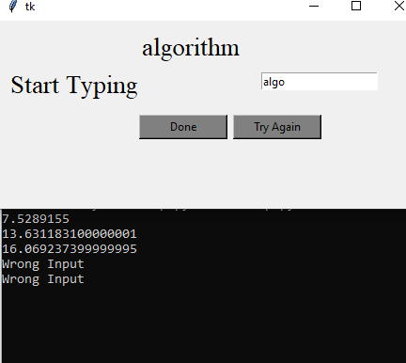

Slide 18
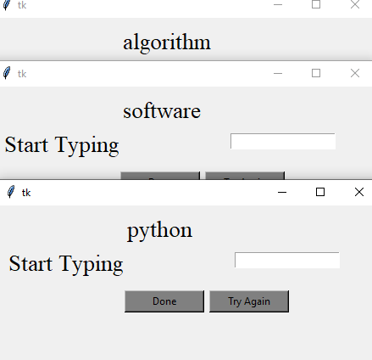
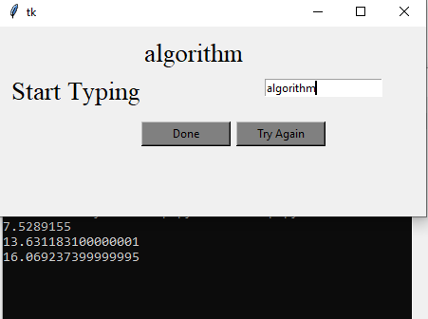

Slide 19
CONCLUSION:
Learning to improve the speed in typing speed test take time as it is a skill to be practiced. Then, practicing the technique should be done on a regular basis. You will save your time and money by learning how to generate your typing speed. Practice is the most important factor that has to be installed in your mindset to achieve speed typing.

Slide 20
THANK YOU

